Slide 1
Thomasville City School Visits Salisbury High School
Notes:
On February 1st Thomasville City Schools with TCS Advisory Council and school board members visited Salisbury High School.

Slide 2
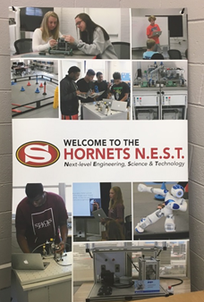
Advanced Manufacturing Fact Finding Mission
Vision
Implementation Process
Partnerships
Funding
Notes:
We wanted to see their Advanced Manufacturing Program to get ideas of how it would look, implementation process, partnerships and funding. We found out that they did exactly what we are doing… Visiting other schools to see their programs.

Slide 3
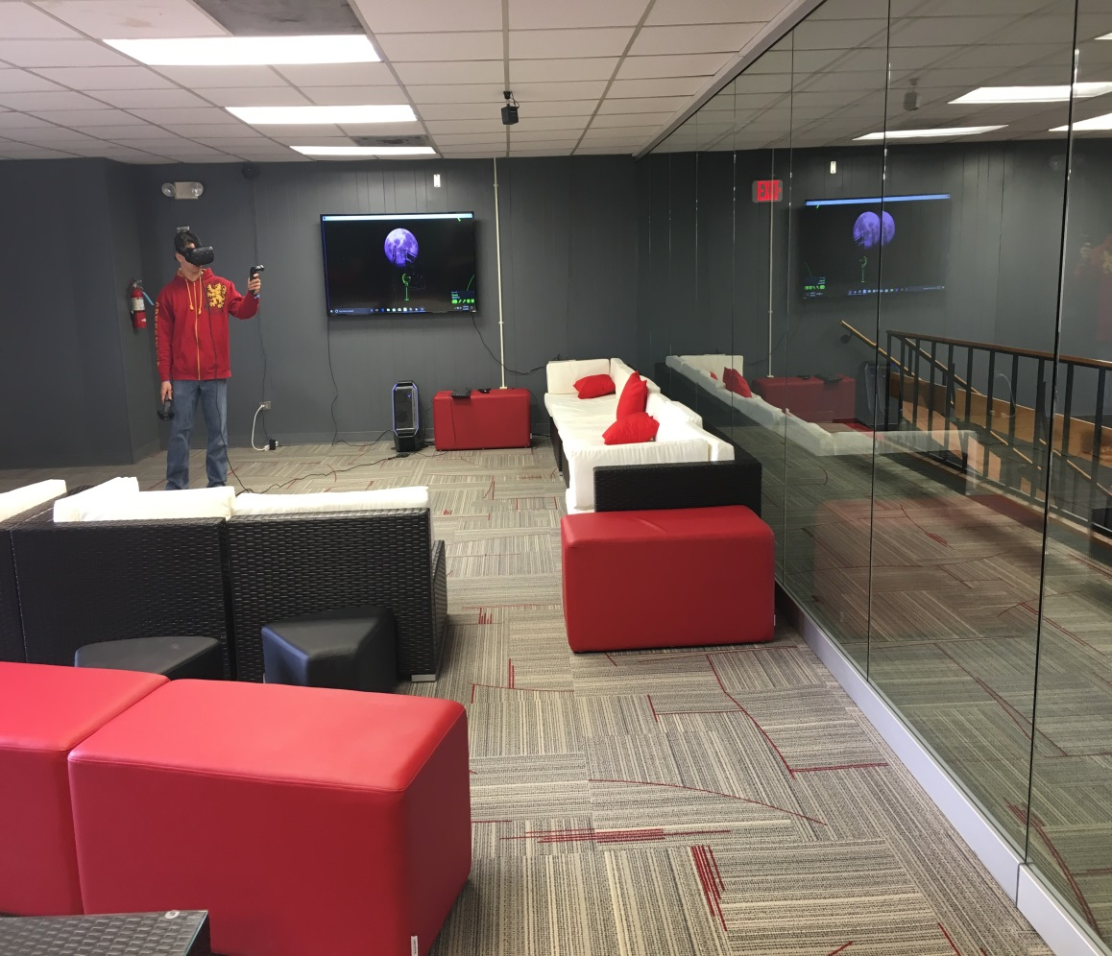
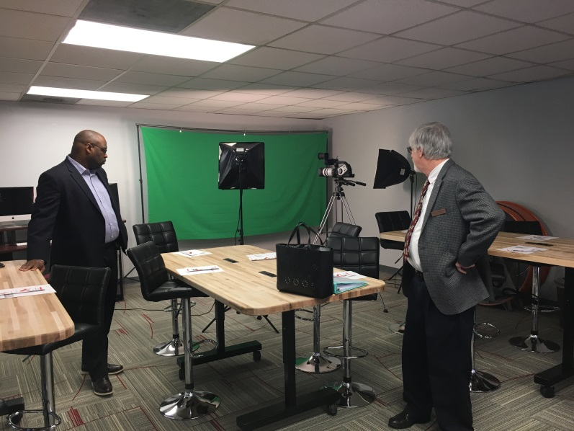
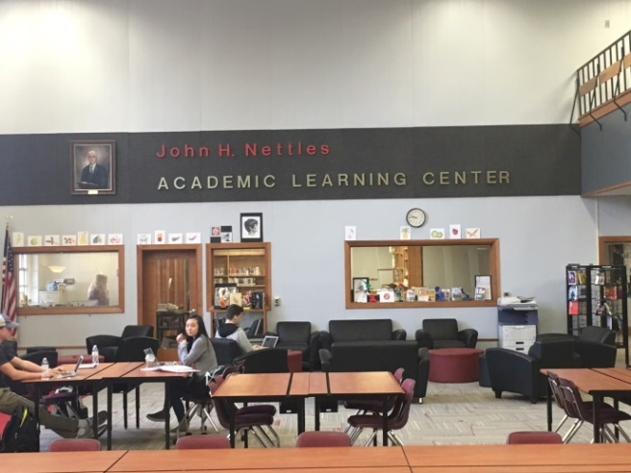
Innovation Center
Collaborative Space for
Students
Staff
Classes
Notes:
We toured their Academic Learning Center and Innovation Center that used to be their old gym. They renovated the area to use as collaborative spaces for students, teachers and classes. The innovation center has a student help desk person that is available for assisting students as they come in. They also have a virtual exploration area, 3-D printers and a video recording area.

Slide 4
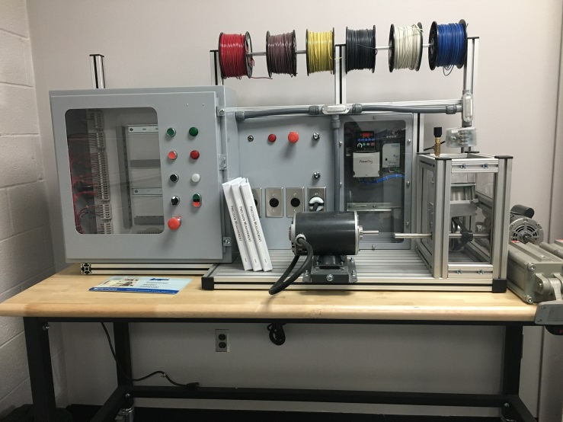
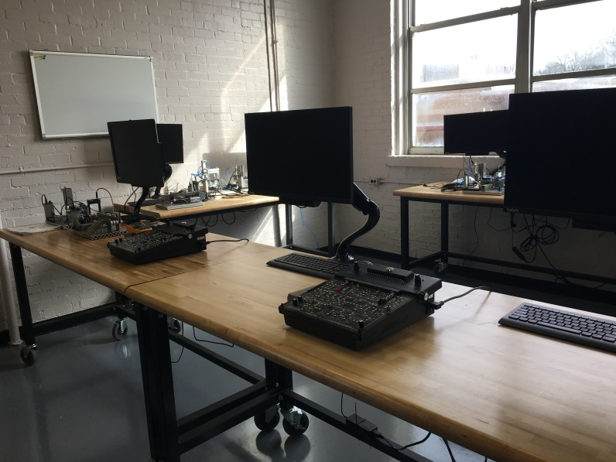
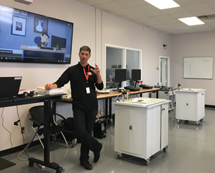
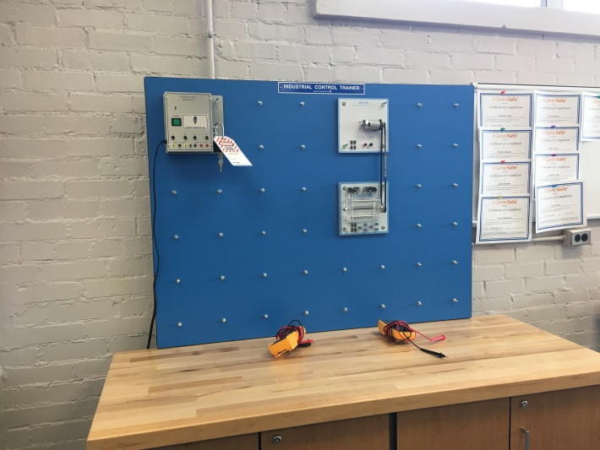
Advanced Manufacturing I & II
Notes:
The student panel discussed their interest in the Advanced Manufacturing program due to the teachers making it interesting and not designed like other classrooms. They spoke about how they are working on equipment that they will see if they were our working in the industry. They also talked about it being fun to work on the equipment but they were also aware that the skills they are learning will prepare them to work in the industry.

Slide 5
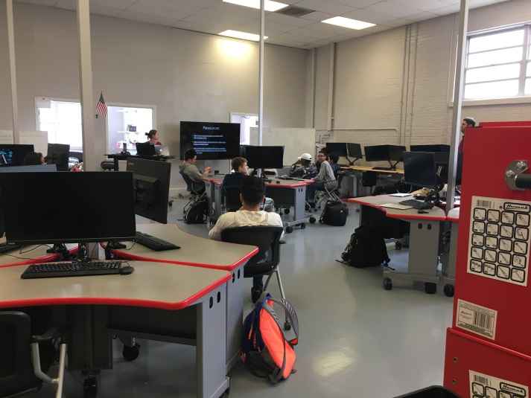
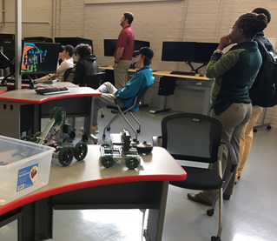
Technology Engineering & Design & Robotics
Notes:
In the TED Class students were doing presentations about different metals and the strengths and weaknesses of the metals. This class also serves as the robotics class and in the pictures you can see the robotics rink where they test their robots and have competitions.

Slide 6
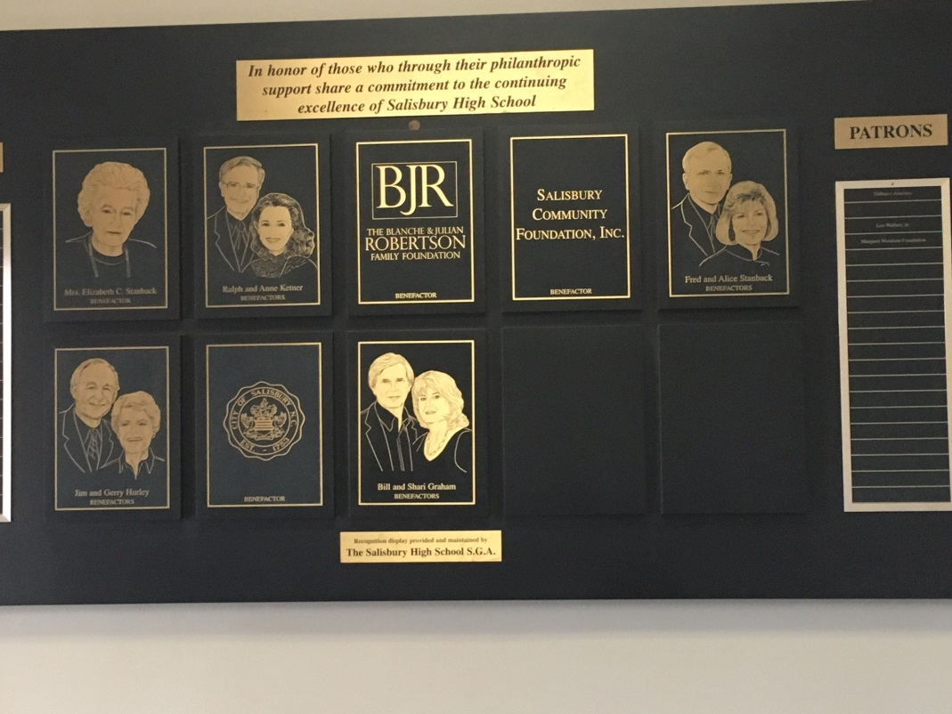
Funding & Partnerships
Notes:
This program was supported by strong community partnerships. The funds for the Advanced Manufacturing Program came from partnership support, local funds, CTE and the Golden Leaf Foundation. They applied for a Golden Leaf Grant in partnership with Rowan-Cabarrus Community College. They each received a portion of the grant funds to implement the Advanced Manufacturing Program at Salisbury High School and extended to the community college program.

