Slide 1
Student Services Updates & Info
TCS board of education meeting
November 10, 2020

Slide 2
Social and emotional wellness in tcs
Social Emotional Learning
The Collaborative for Academic, Social, and Emotional Learning (CASEL) defines SEL as the fostering of social and emotional competencies through explicit instruction and through student-centered learning approaches that help students engage in the learning process and develop analytical, communication, and collaborative skills.
Mental Health
Mental health includes our emotional, psychological, and social well-being. It affects how we think, feel, and act. It also helps determine how we handle stress, relate to others, and make choices. Mental health is important at every stage of life, from childhood and adolescence through adulthood.
*definitions according to Illuminate Education, Inc and mentalhealth.org respectively*

Slide 3
Social and emotional wellness in tcs
Second Step SEL Curriculum (K-8)
Restorative Circles
Trauma-Informed Schools
Youth Mental Health First Aid
Traumatic Event Debriefing (TED) Team
CAMS Suicide Assessment & Protocol/Safety Plan
Positive Behavior Intervention Support (PBIS)
Mental Health Continuum of Services
Employee Assistance Program
Individual Counseling
Webinars
Life Planning
Financial Planning
Wellness Activities w/ the District Wellness Coordinator
Walking Challenge
Self Care Sessions
Health Fair
Cooking Demonstrations
Virtual Calming Room
Professional Development Opportunities (SEL, trauma-informed, Restorative Circles, etc.)

Slide 4
Social and emotional wellness at Thomasville primary
Students:
Second Steps SEL Curriculum (daily)
Classroom Guidance Lessons – “The New Normal”
School Based Therapy (by referral only)
Student Check-ins
Staff:
Yoga/Zumba/Walking Club/Class
Staff Gathering/Activities (i.e. drinks & design)
Professional Development Opportunities (building relationships w/ students virtually & face to face, self care for educators, etc.)

Slide 5
Social and emotional wellness at liberty drive elementary
Students:
Classroom Guidance Lessons
Teacher led SEL Lessons
Class Dojo Video/Lessons
Revision of PBIS Matrix to include COVID protocols
Welcome Back to School Activities & Training
Second Step SEL Curriculum
Small Groups (i.e. virtual lunch sessions)
Individual Counseling
School Based Therapy
Staff:
Wellness Wednesdays (stress release & fun activities)
Support/Wellness Check Small Groups
Thankful Treats & Celebrations
SEL PD for adults and student support

Slide 6
Social and emotional wellness at Thomasville Middle
Students:
Second Step SEL Curriculum
Student Success Team
P.R.I.D.E. Room (student wellness room)
Wellness Wednesdays
Wellness Checks
Home Visits
Small Groups (Why Try)
School Based Therapy
Staff:
“The Corner Pocket” – Staff Wellness Room
1-on-1 Check-ins
Breakfast/Lunch
Relaxed Dress Code – Remote ONLY
Open Two-Way Communication (hearing & addressing concerns, keeping staff informed)
Professional Development (self-care, SEL for adults)

Slide 7
Social and emotional wellness at Thomasville high
Students:
Weekly Counseling Sessions
Canvas SEL Lessons
Check-in Assessments
Grade Level/Class Meetings
Bulldog Time/Intervention Time
Discussion Boards
Individual Counseling/Check-ins
Virtual Calming Room Activities
School Based Therapy
Staff:
Monthly PLCs with SEL Focus
Staff Meetings Opened with SEL/Mindful Moments
Breakfast/Lunch
Feedback Sessions with Staff & Admin
Book Studies
Relaxed Dress Codes (Jeans Fridays)
Snack Bags/Special Notes
Staff Breaks

Slide 8
Attendance goals ~ 2020-2021 SY
TPS
3-9 ~ 360 students
10-17 ~ 169 students
18+ ~ 70 students
THS
3-9 ~ 211 students
10-17 ~ 104 students
18+ ~ 147 students
LDES
3-9 ~ 171 students
10-17 ~ 67 students
18+ ~ 24 students
TMS
3-9 ~ 180 students
10-17 ~ 128 students
18+ ~ 62 students

Slide 9
Panorama surveys (students, staff, families)
PANORAMA – WHAT IS THE PROGRAM?
PANORAMA – HOW WILL DATA BE USED?
To Re-establish a baseline for social emotional learning knowledge and understanding from students based on the current status
informal comparison to 2019-2020 data
To get a pulse from students, staff and families on their thoughts/feelings of being back in school during the pandemic. Additionally, to assess needs of each group.
TIMELINE OF ACTIVITIES
October 19 – October 23:
Meet with admin to establish a plan for when surveys will be completed and how
Inform staff of survey plan and how to complete surveys
October 26 – November 6 (with the possibility to extend 1 week):
Administer surveys to students
Window for staff & family surveys

Slide 10
Family and Community Engagement (FACE) in TCS
We are continuing with our partnership with Scholastic, Inc. This is year 3 of the program to “Build Capacity” of school staff and families.
Each school is in the process of training their full staff on Foundations of FACE
Principals met with the trainer to brainstorm further needs/plans for next staff training (to take place late fall/early spring).
FACE trainer will spend some time with district leadership to build capacity and plan district level activities.
The next step is to begin providing opportunities for our parent partners to begin participating in training opportunities and building their capacity.
The culminating activity will be a PD Day with Dr. Karen Mapp on the Dual Capacity-Building Framework and FACE
Schools have used strategies and information learned from FACE training on past and current school activities (i.e. Open House/Meet the Teacher, Title I/Curriculum Night, Tea & Talk, etc.)

Slide 11
TCS Student Assignment (out of district admissions/district releases)
Out of District Students
44
Students Released from TCS
28
***updated as of 11/5/2020***

Slide 12
McKinney-Vento in TCS
Thomasville Primary
34
Liberty Drive
17
Thomasville Middle
20
Thomasville High
15
Homeless School
4
District Total: 90
***updated as of 11/5/2020***

Slide 13
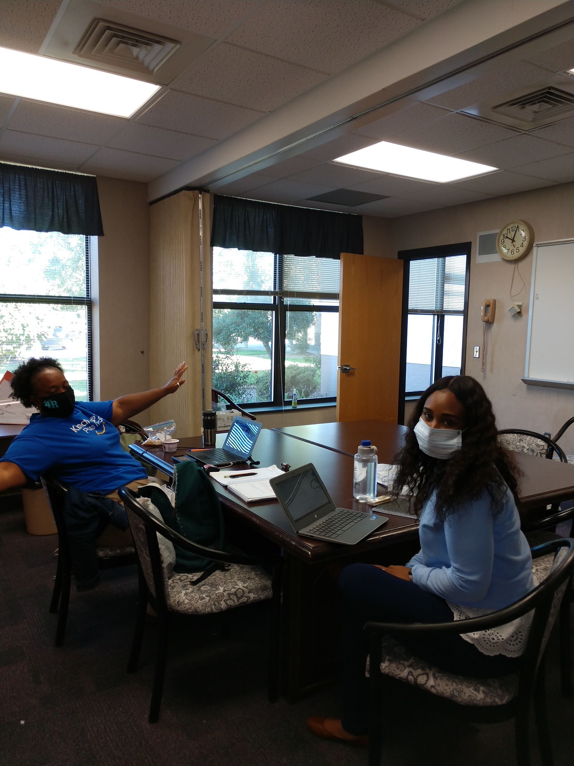
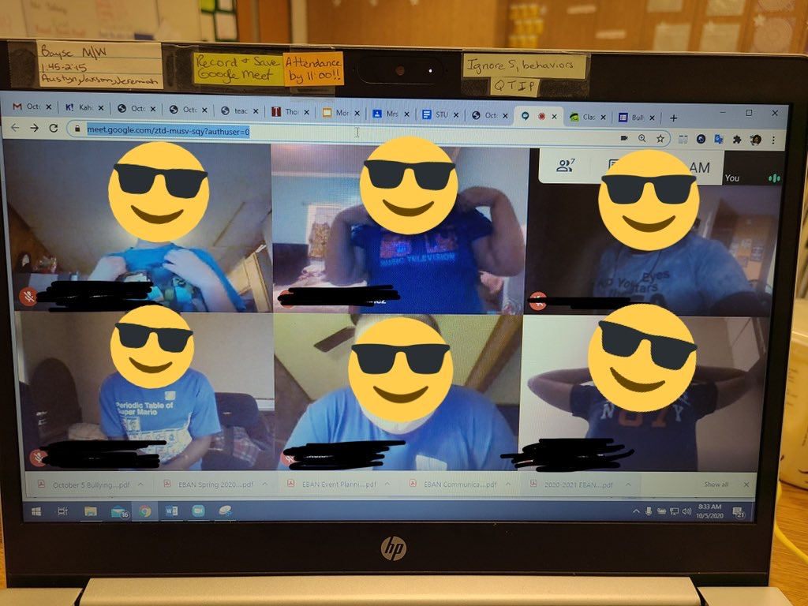
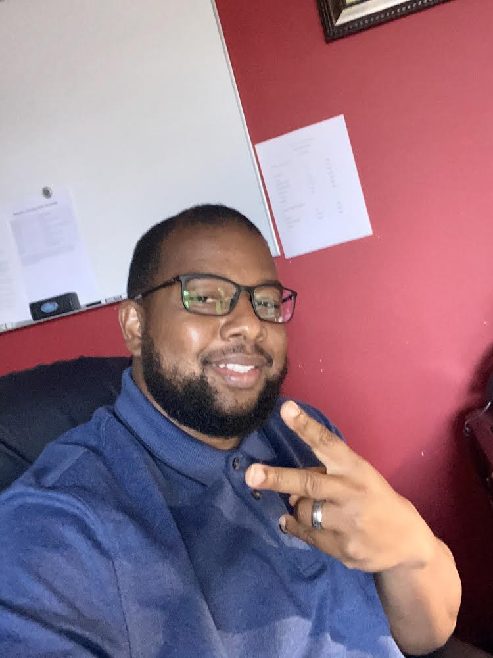
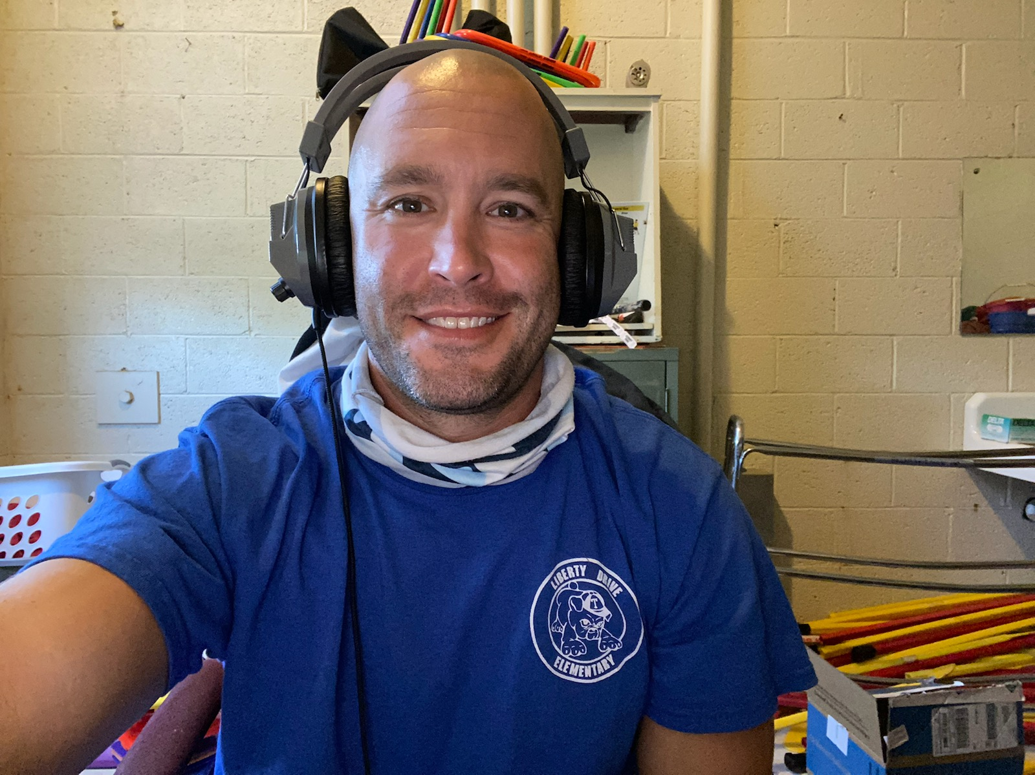
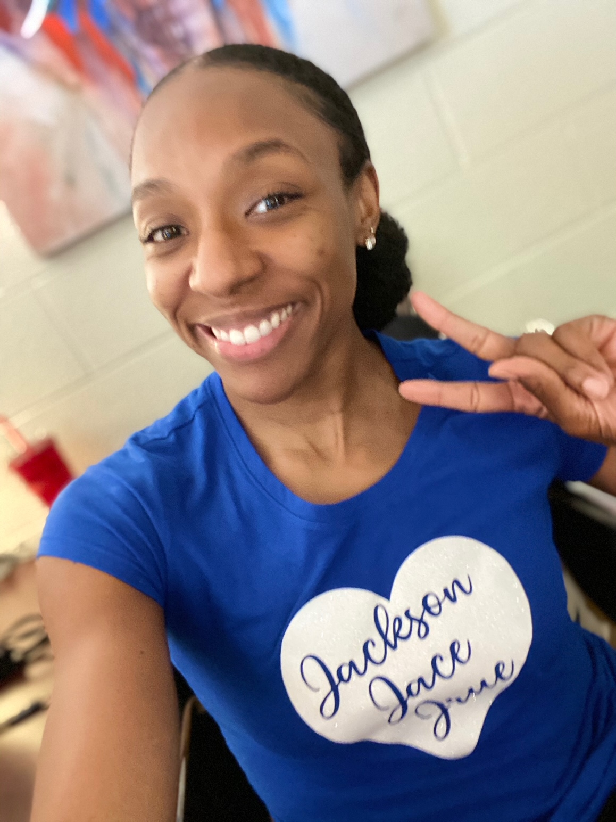
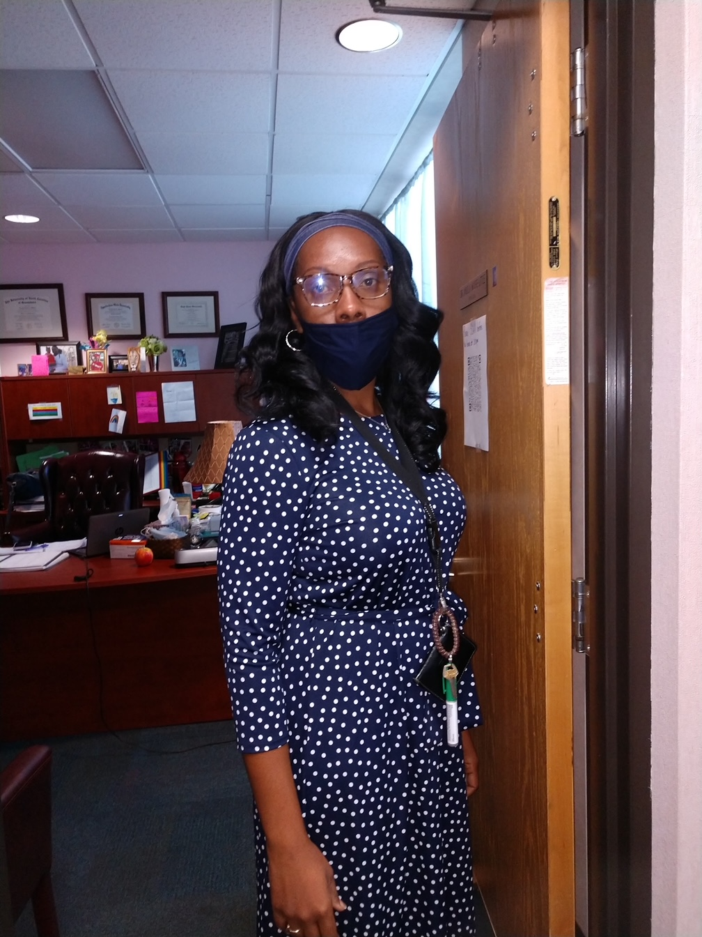
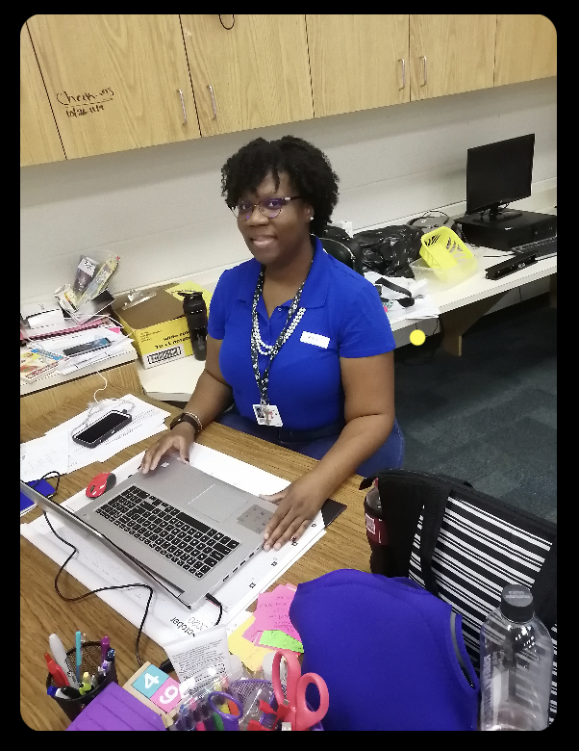
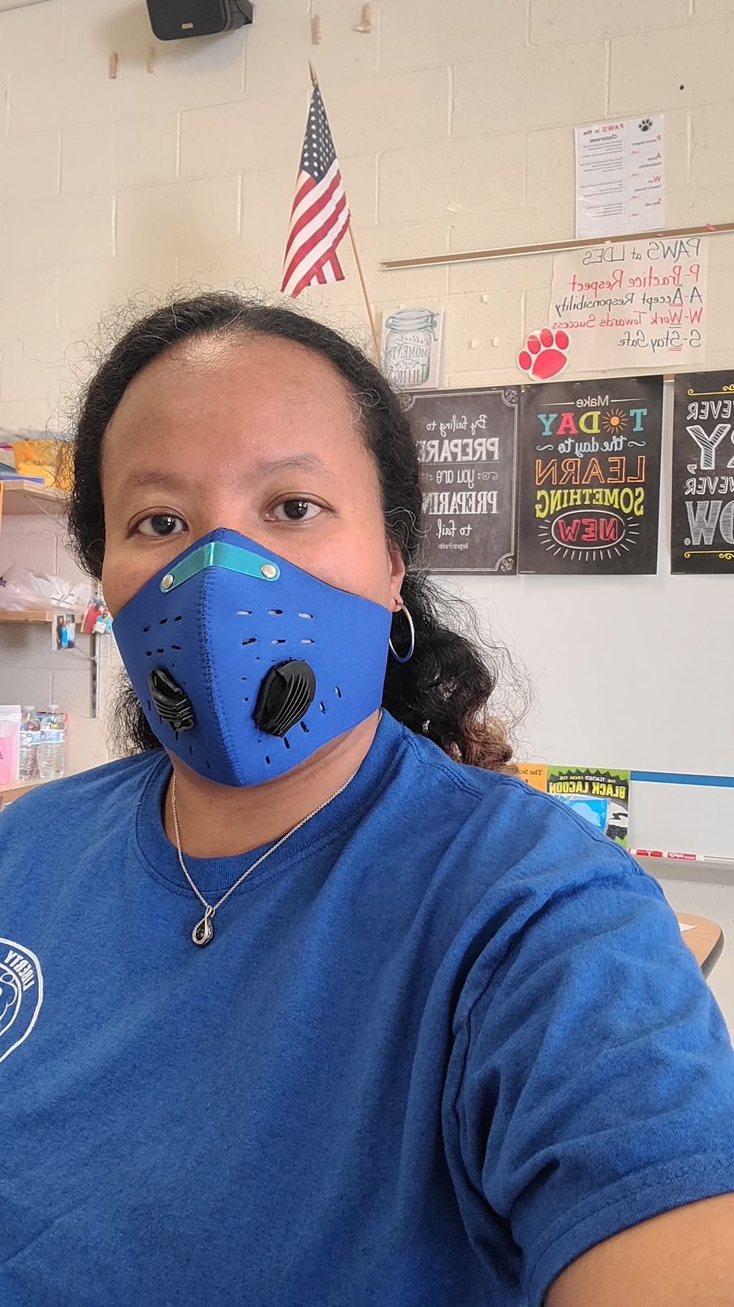
World day of bullying prevention ~ Blue shirt day 2020

